Slide 1

Shiny

Slide 2







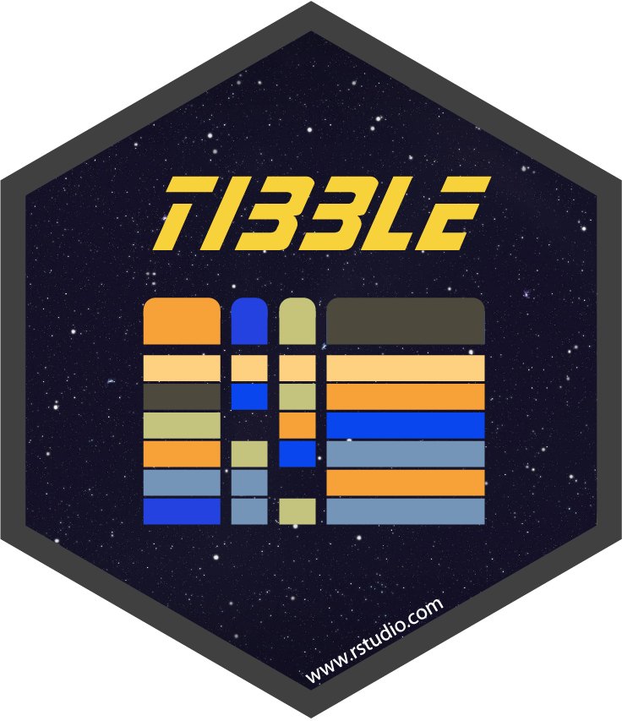
The cool kid

Slide 3
Well, what is it?
An R package, duh
An R framework that allows you to build interactive web applications
Using Bootstrap 4
Divides the screen into 12 columns
Automatically rescales and rearranges based on screen size!
Core:
ui
Controls the look of a page
server
Controls the logic
Continuously monitors the ui (reactivity)
shinyApp
Puts it all together

Slide 4
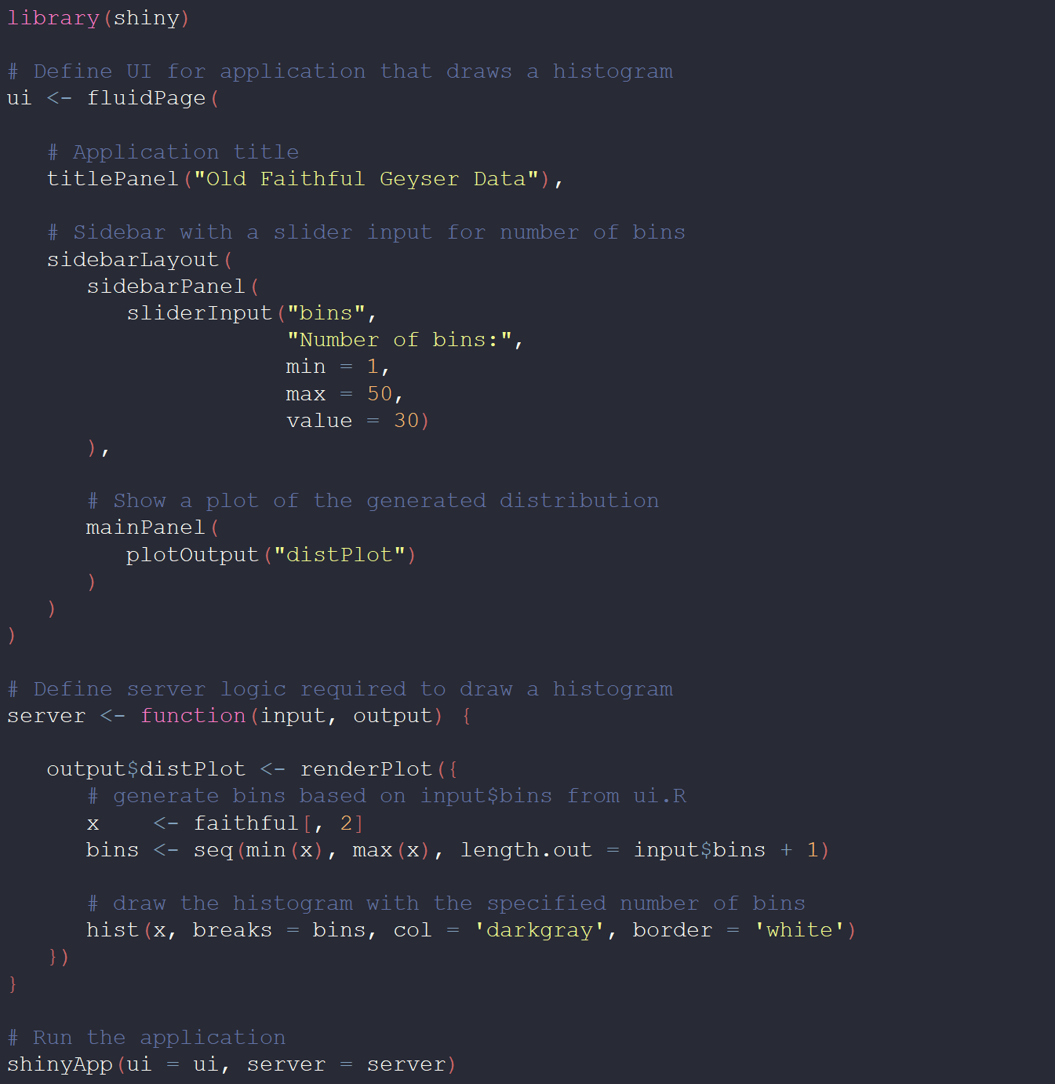
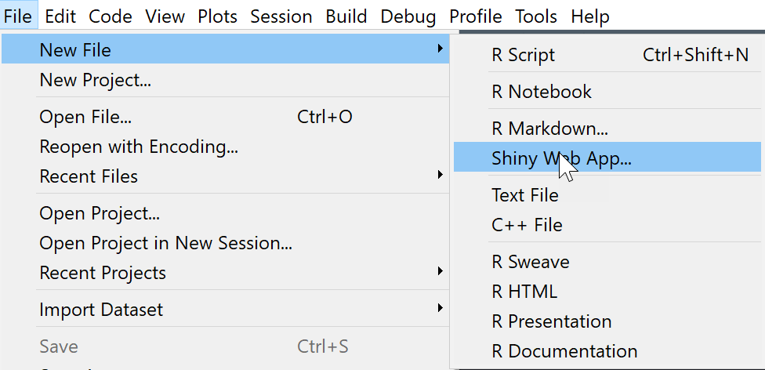
Let’s take a look
ui object
Old Faithful Geyser app
server function

Slide 5
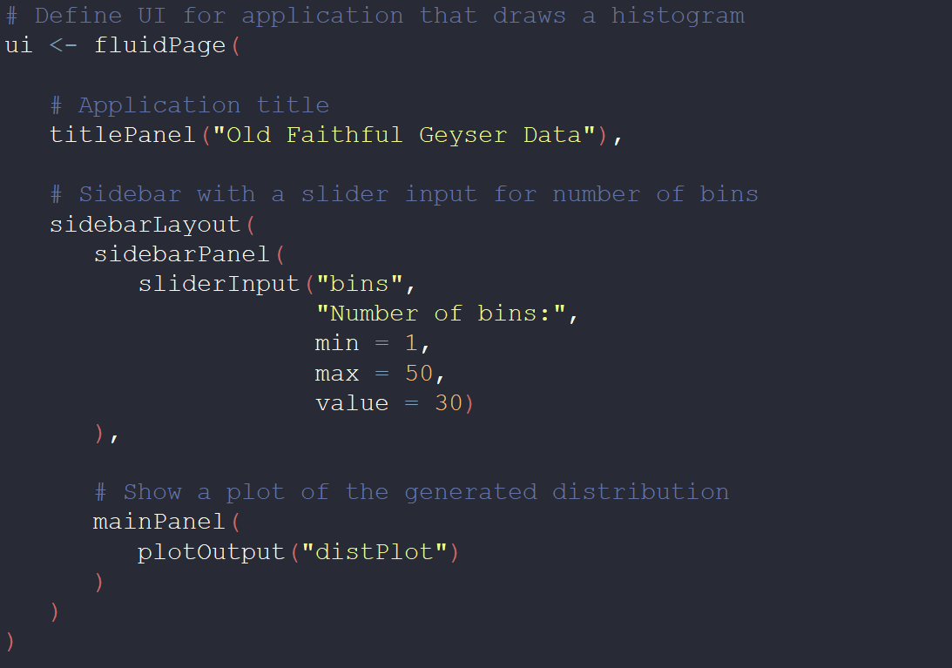
Break it down for me
fluidPage()
titlePanel()
sidebarLayout()
sidebarPanel()
mainPanel()
12
4
8
Notes:
Start with the UI – a de facto HTML file
sidebarLayout just one of many layout functions in Shiny (verticalLayout, flowLayout, etc.)
fluidPage - “div class = container-fluid” – width 12 (columns wide)

Slide 6
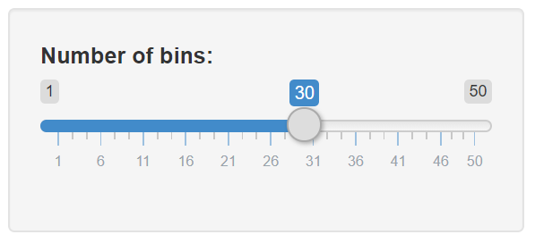
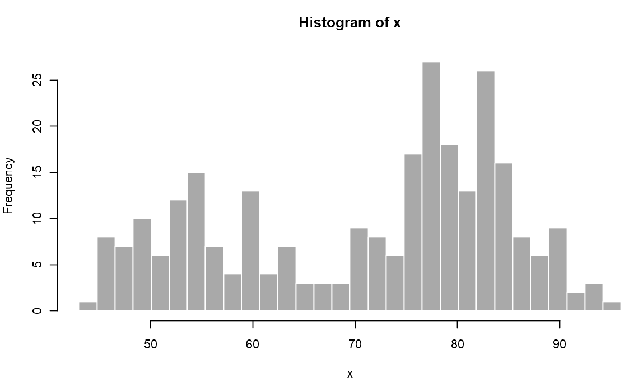
Break it down for me pt.2
object id
* Check the cheat sheet for all possible widgets included in the shiny package
Notes:
Check the cheatsheet for all possible widgets included in the shiny package

Slide 7
Render (server) vs Output (ui) functions
Every rendered object has a corresponding output object in the ui
Fyi: “input” is a list that holds all inputs from the ui that gets passed to the server. That is why we we can call input with a ‘$’.
Notes:
Input list of inputs
Check the handy-dandy cheatsheet for all pairings

Slide 8
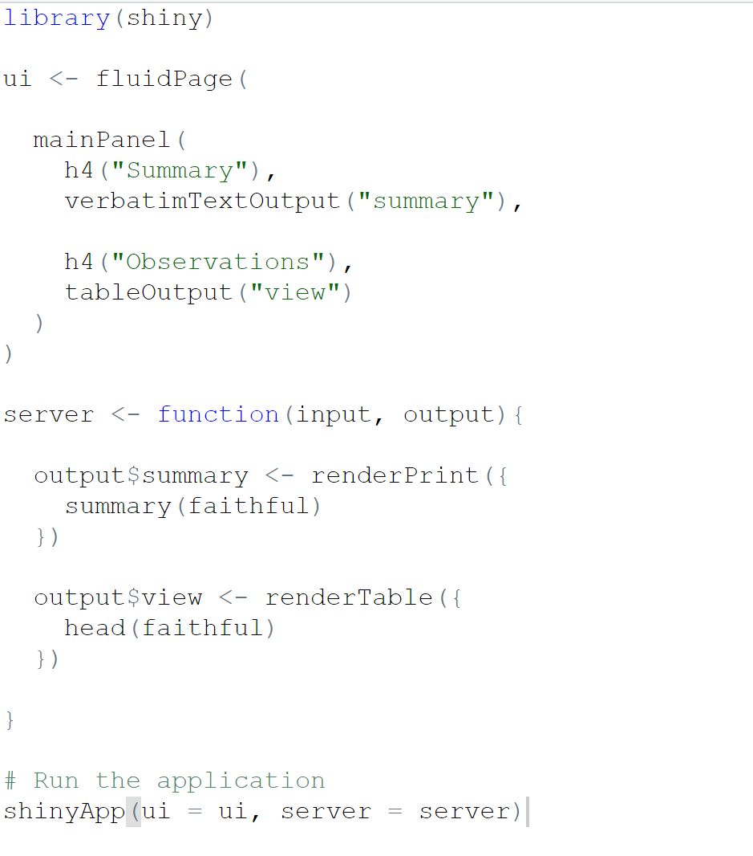
More render/output pairs
In the UI:
verbatimTextOutput()
Prints the results from the summary() function
tableOutput()
Displays a table
In the server:
renderPrint()
Runs the summary() function on ‘dataset’ and stores
renderTable()
Creates a table from the top 10 records

Slide 9
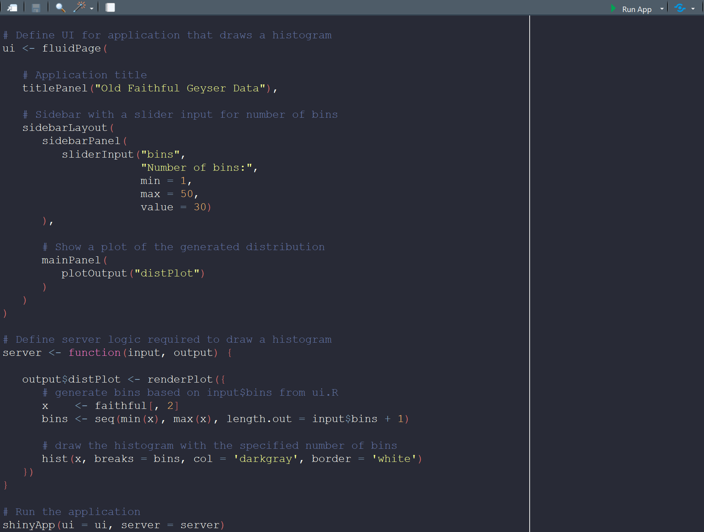
Last step
Create the Shiny app object and run it!

Slide 10
Good resources
Cheat sheet
https://shiny.rstudio.com/images/shiny-cheatsheet.pdf
Shiny tutorials via R Studio or DataCamp
https://shiny.rstudio.com/tutorial/
Inspiration
https://www.rstudio.com/products/shiny/shiny-user-showcase/
http://www.showmeshiny.com/
Examples
https://github.com/rstudio/shiny-examples
Notes:
Literally everything you need to know in the cheat sheet!

Slide 11
Let's Boogie!
There's a repo on GitHub I made for this lecture
Download it/clone it!
https://github.com/labouz/teachShiny

Slide 12
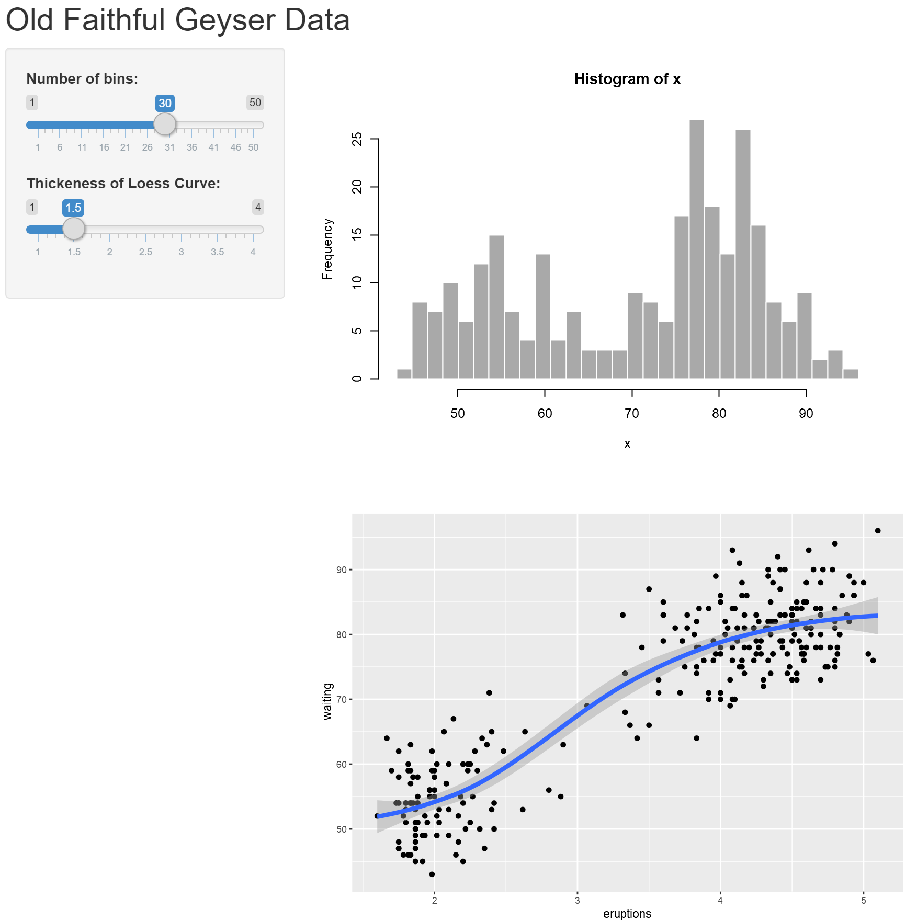
Exercise!
Objective: to add a scatterplot with a Loess smoother showing the relationship between eruption and wait times. The user has the ability to adjust the thickness of the Loess line.
How?
Render a ggplot object in the server, x=eruptions, y=waiting
geom_point
Hint: renderPlot({ your plot })
Add the Loess smoother to the plot
geom_smooth (find the argument for line thickness – keep it in mind)
Add the slider input widget to the ui
Range 1 to 2
Set a default value
Add a step argument for .5 increments
Go back to your plot in the server and add the thickness input object as the argument for the Loess line thickness (from step 2)
Hint: input$yourThicknessInput

Slide 13
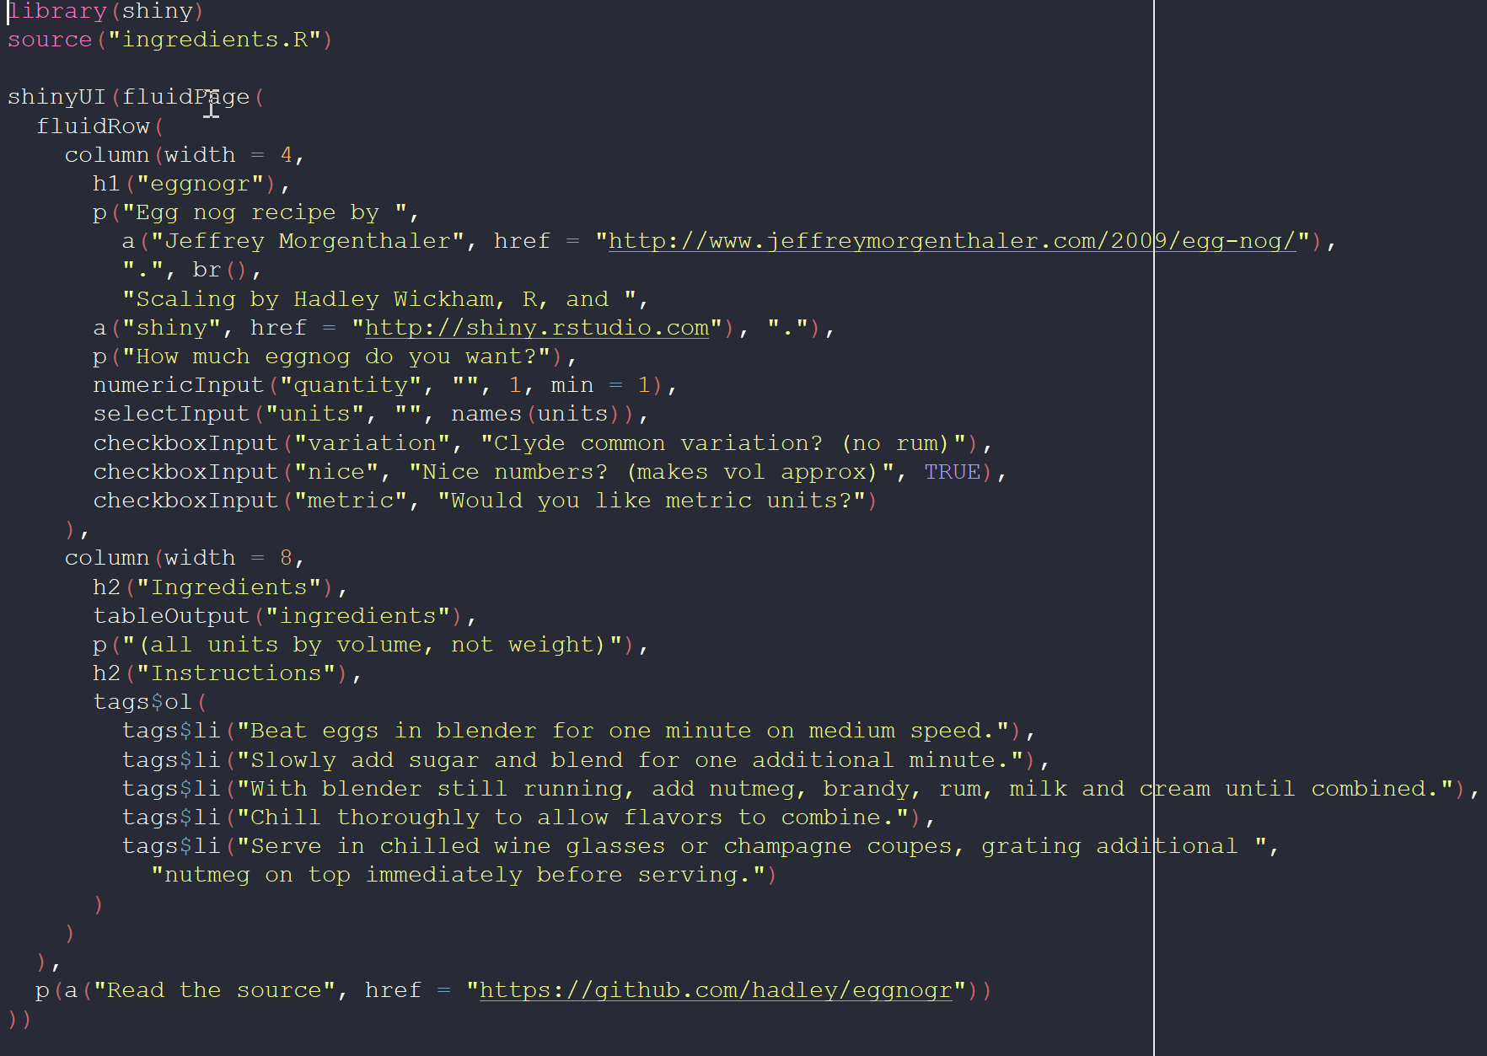
A little more involved example
Hadley’s eggnog app
https://hadley.shinyapps.io/eggnogr/
fluidRow layout
HTML tags:
a → link
p → paragraph
The ui
HTML tags:
ol → ordered list
li → list item
Notes:
Load the app in R Studio and Run it
Describe the elements within R Studio
Html tags cheat sheet (glossary)! https://shiny.rstudio.com/articles/tag-glossary.html
Talk through the each of the shiny components of this app……CR will introduce mapping

Slide 14
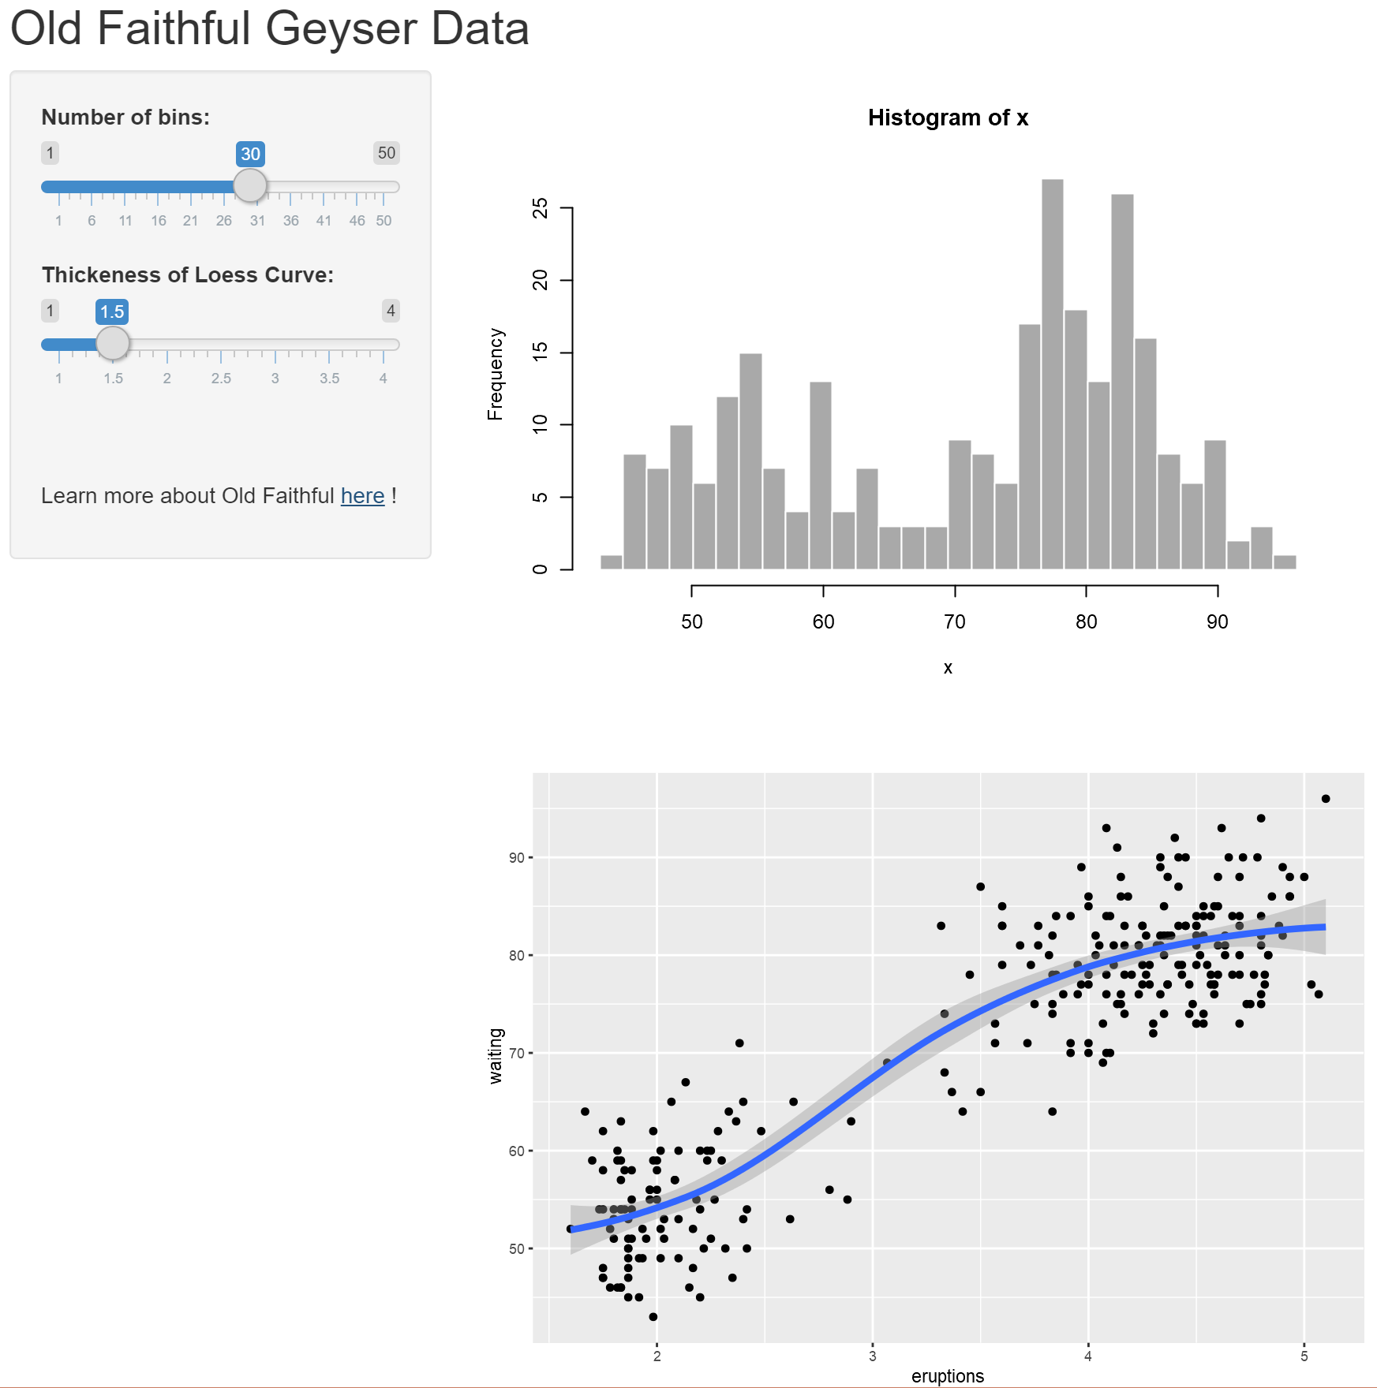
Exercise!
Add a link to the Old Faithful Wikipedia page!

Slide 15
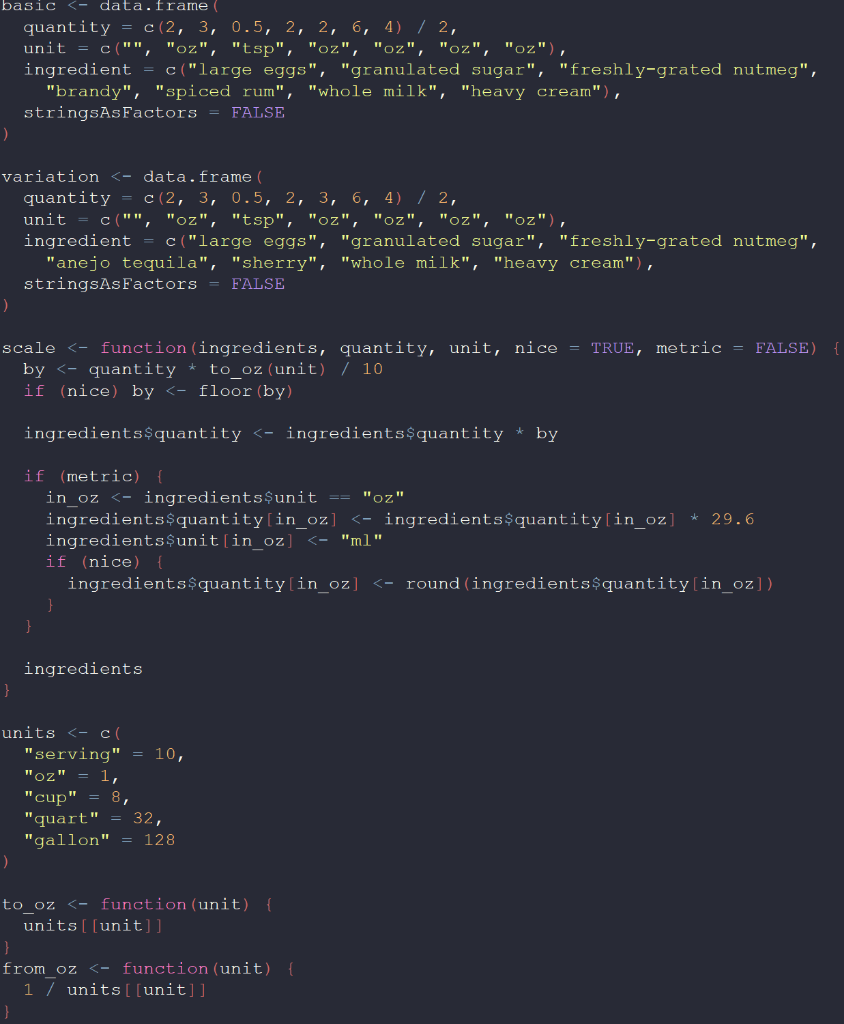
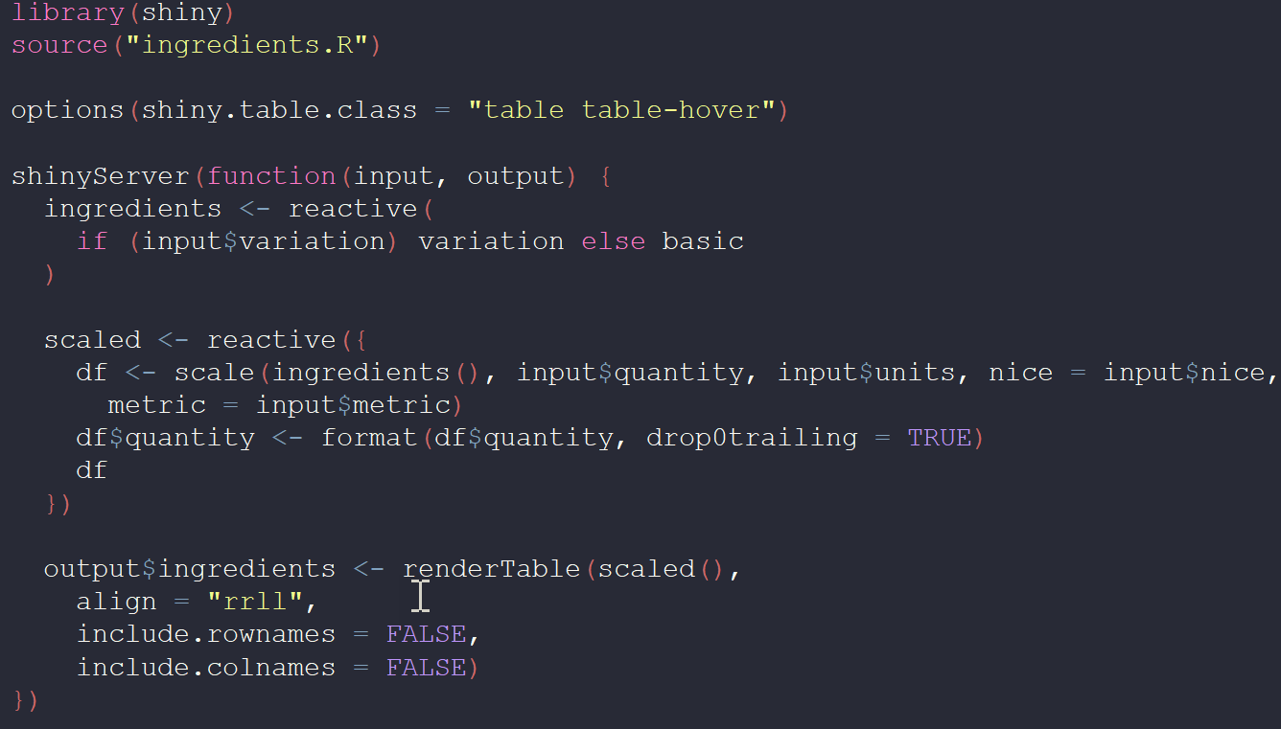
A little more involved example pt.2 - sourcing
Calling another r script (usually a function) from within your server
What’s this?
We’ll get to this in a second…
The server
Notes:
Talk about each of the arguments to the scale functions within the ingredients.R scripts and relate the input variables to the fact this is wrapped in a reactive object.
renderTable() -> scaled() = the reactive table created above, align = 'r','c','l'

Slide 16
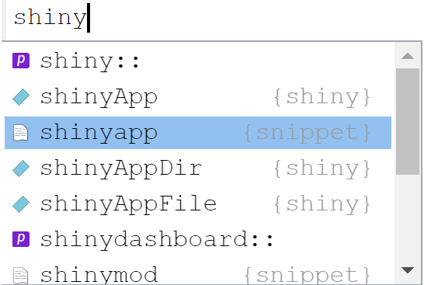
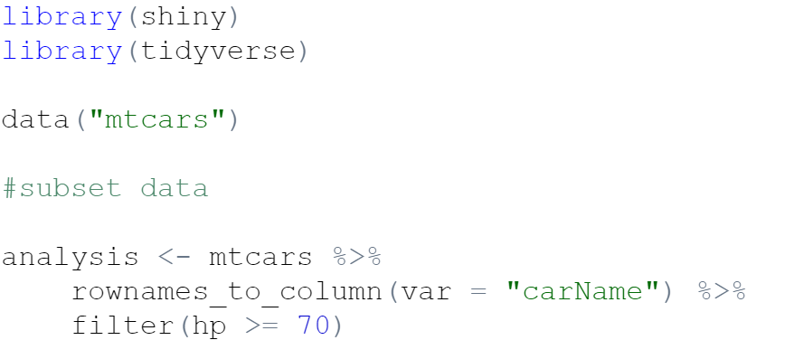
Exercise!
Build baby app
Build Shiny Web App
Open a new r script
Load the shiny and tidyverse libraries
Start a shiny app using the shiny app snippet
Start typing 'shiny' in your script and RStudio will offer autocomplete suggestions
Use 'mtcars' data
Save a subset of the data, assign to analysis
Give your app a title
Include an input widget
Selection input of front gears
you choose! – SelectInput, RadioButtons…
Include a render/output pair
Scatterplot of MPG vs HP
Notes:
This will be a non-reactive example

Slide 17
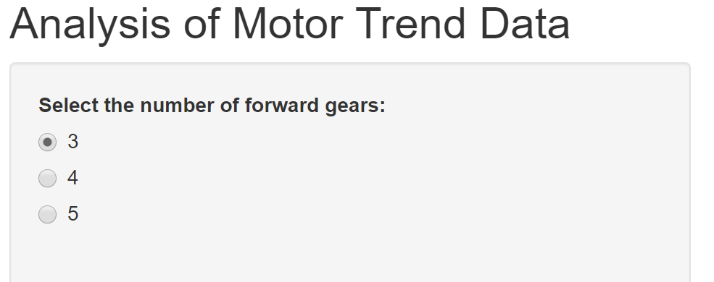
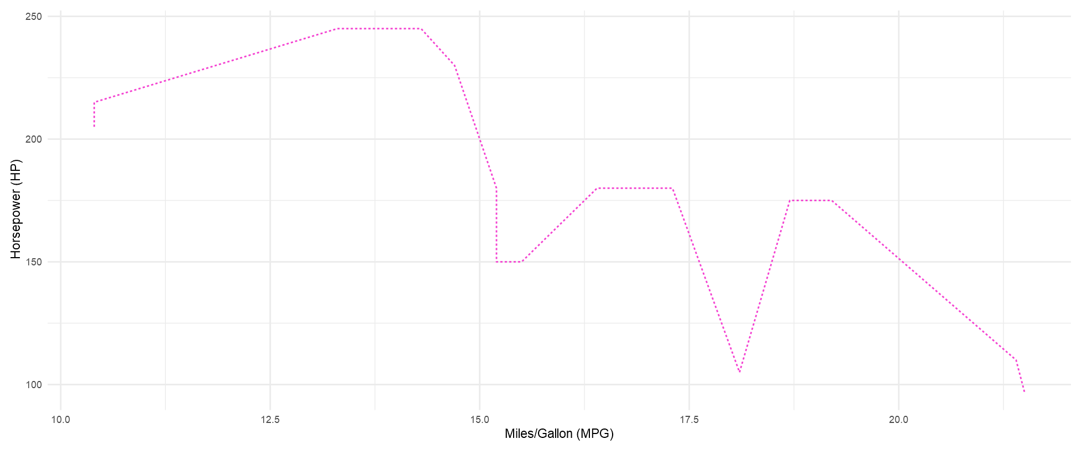
Exercise (cont)

Slide 18
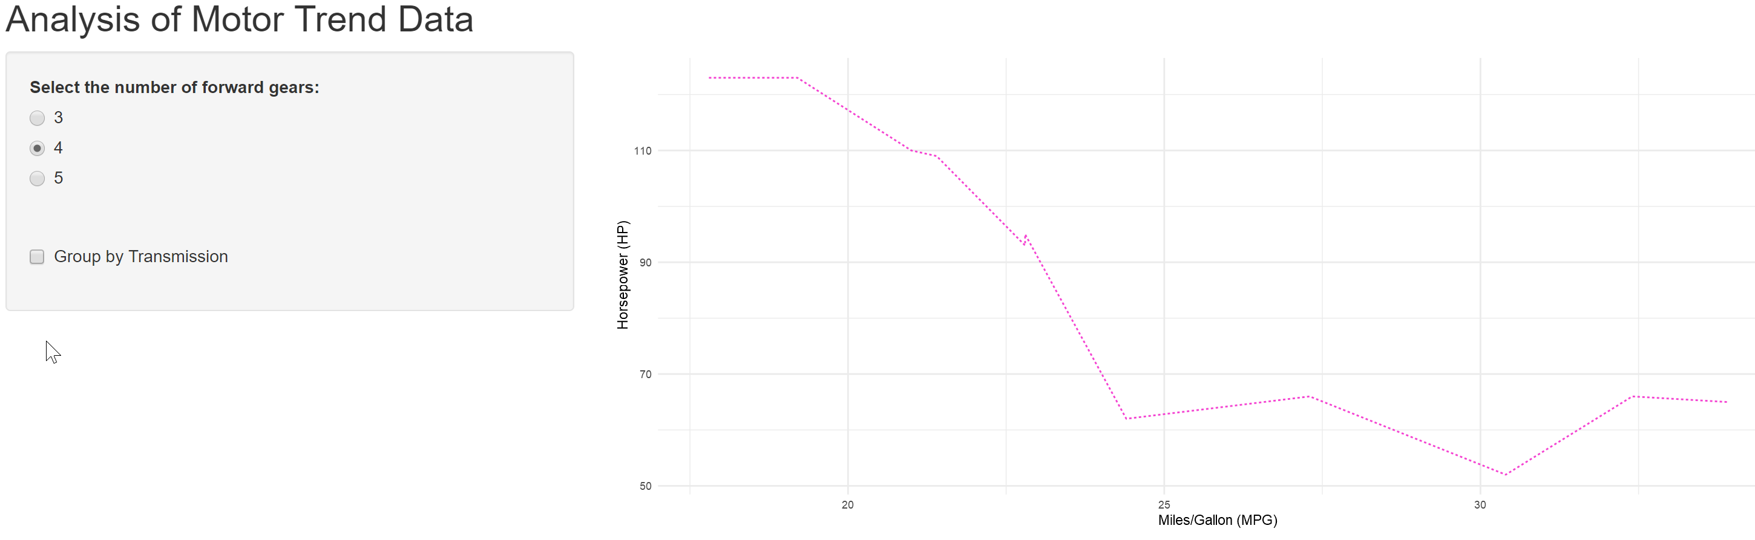
Reactivity…..what's that?
Simply, it allows your app to instantly update itself whenever the user makes a change
render* functions are reactive outputs!
Notes:
Reactivity is what makes your Shiny apps responsive. It lets the app instantly itself whenever the user makes a change. https://shiny.rstudio.com/articles/understanding-reactivity.html for an in-depth explanation of reactivity

Slide 19
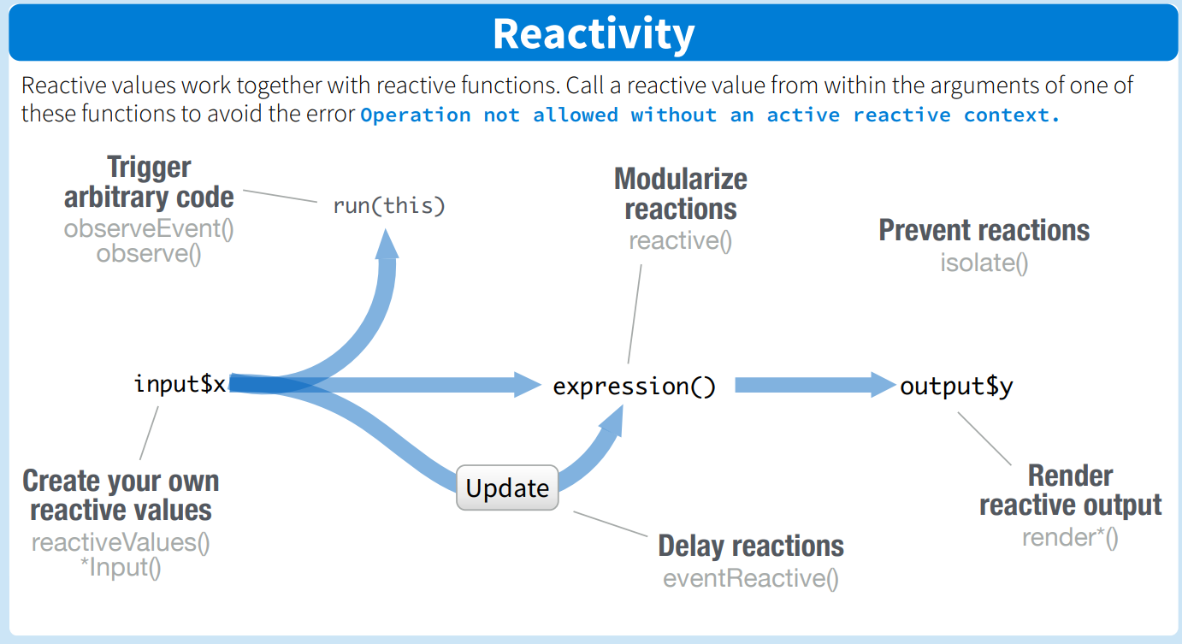
Reactivity (pt. 2)
Reactive data that changes based on user input
Several types of reactive functions
Ex. A ‘Go’ button to take you to another page
All the render* functions you put in the ui – i.e. renderPlot, renderTable, renderText…
Ex. An ‘Update’ button
Notes:
A reactive expression is defined as one that transforms the reactive inputs to reactive outputs. These perform computations before sending reactive outputs.
Understanding isolate() : https://shiny.rstudio.com/articles/isolation.html

Slide 20
Reactivity (pt.3)
Let you control which parts of your app update when, which prevents unnecessary computation that can slow down your app.
Input() functions are reactive values you create!
reactive() → a wrapper that tells the server to wait until it receives input from the user before processing
Notes:
Making our data into a reactive expression caches what's in the data to reduce computation, allows this data to be called on by other chunks of code, notifies its dependencies when it has been invalidated. This expression is called in regular function syntax – analysisSub() – with parentheses.

Slide 21
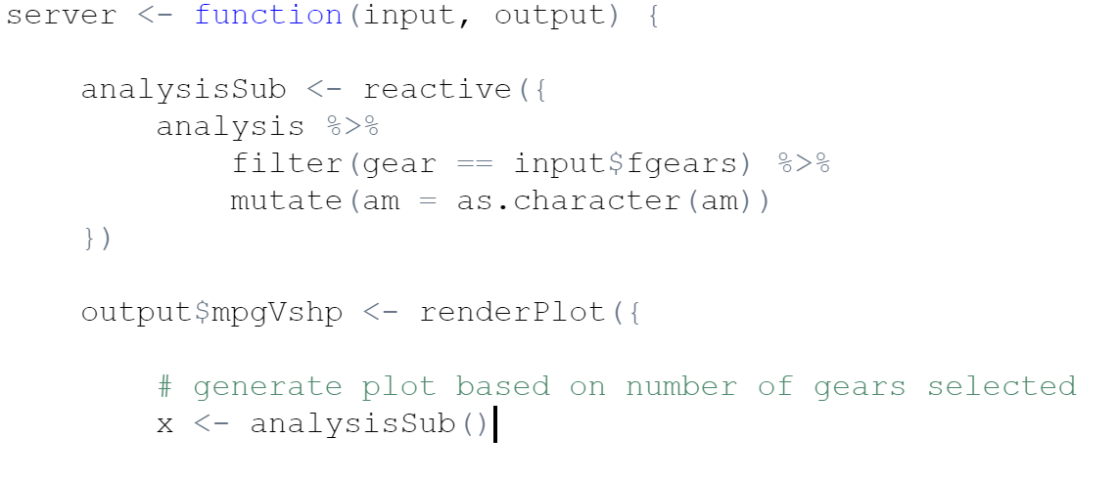
Exercise
Let's make our analysis data reactive!
Notes:
Making our data into a reactive expression caches what's in the data to reduce computation, allows this data to be called on by other chunks of code, notifies its dependencies when it has been invalidated. This expression is called in regular function syntax – analysisSub() – with parentheses.

Slide 22
observeEvent() vs eventReactive()
eventReactive(eventExpr, ….) → creates a reactive value that changes (can be updated) based on eventExpr → use to create a calculated value that only updates in response to an event
observeEvent(eventExpr, ….) → triggered once based on eventExpr → perform an action in response to an event
library(shiny)
shinyApp(
ui = basicPage( actionButton("go", "Go")),
server = function(input, output, session) {
observeEvent(input$go, {
print(paste("This will only be printed once; all",
"subsequent button clicks won't do anything"))
}, once = TRUE)
}
)
shinyApp(
ui = fluidPage(
column(4,
numericInput("x", "Value", 5),
br(),
actionButton("button", "Show")
),
column(8, tableOutput("table"))
),
server = function(input, output) {
# Take an action every time button is pressed; # here, we just print a message to the console
observeEvent(input$button, {
cat("Showing", input$x, "rows\n")
})
# Take a reactive dependency on input$button, but
# not on any of the stuff inside the function
df <- eventReactive(input$button, {
head(cars, input$x)
})
output$table <- renderTable({
df()
})
}
)
Notes:
https://shiny.rstudio.com/reference/shiny/1.0.0/observeEvent.html

Slide 23
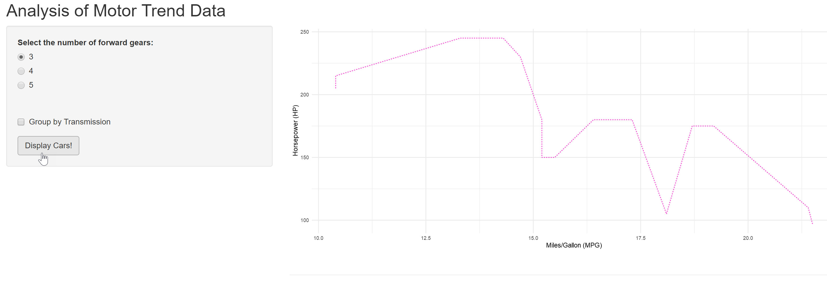
exercise
I will show you how to:
Add an observe event to display the cars represented in the graph
You will:
Do this in your baby app with me!

Slide 24
Flex it – A Tale of Two Dashboards
Shiny or Flex? And what’s the difference?
Shiny Dashboard
Install.packages(“shinydashboard”)
Flex Dashboard install.packages(“flexdashboard”)
More involved but more powerful
Allows for more advanced features
Capacity for more features (i.e. login)
Quick = minimum fuss
HTML shortcuts
Flexible title bar
Flexible layouts
Auto resizing for browsers/mobile
App in one .Rmd file
Useful for quick prototypes
Notes:
Flex – simple html shortcuts that allow for easy construction, title bar organizes app into different pages and put icons/links to GH etc, one .rmd doc vs separate server/ui files

Slide 25
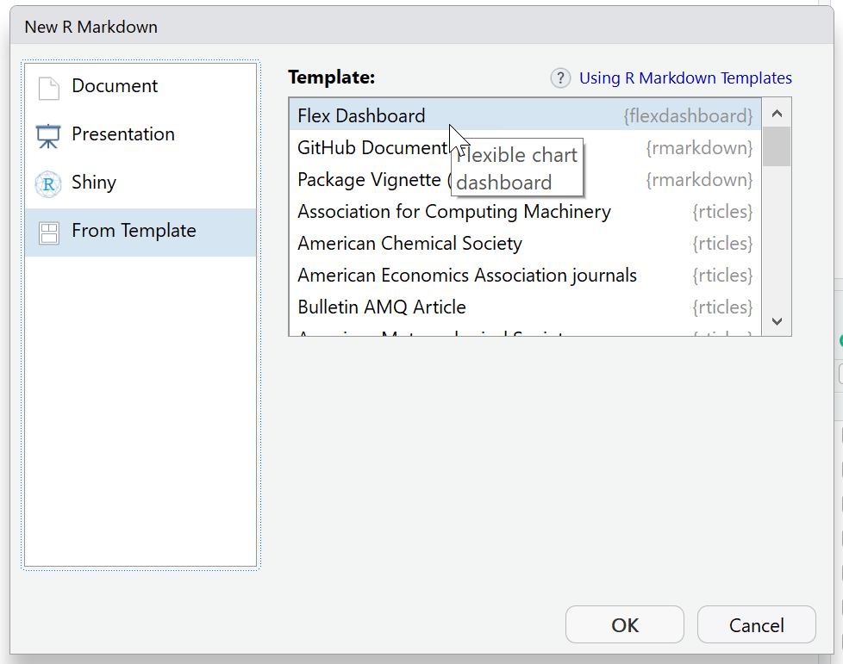
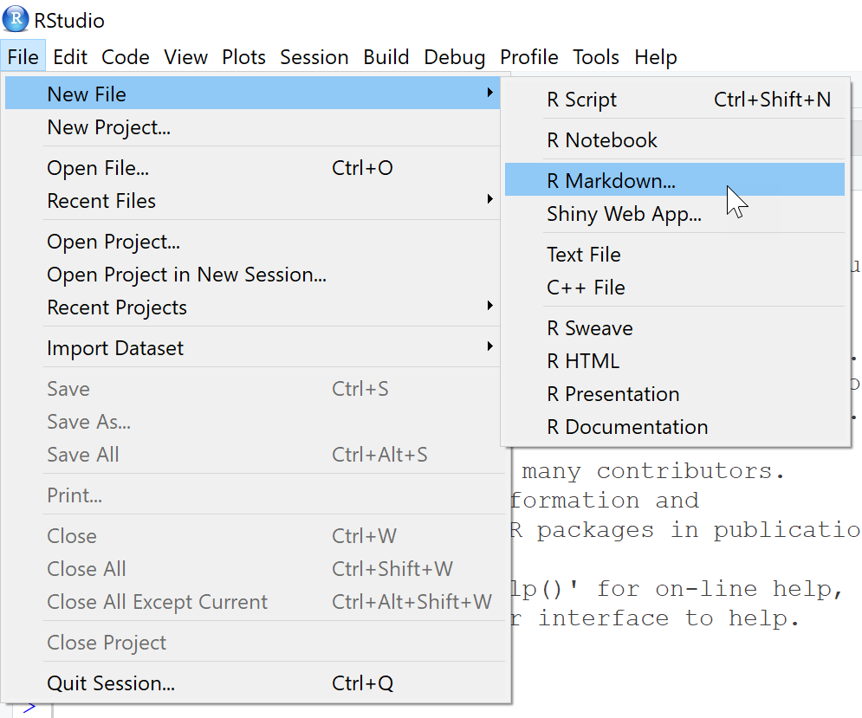
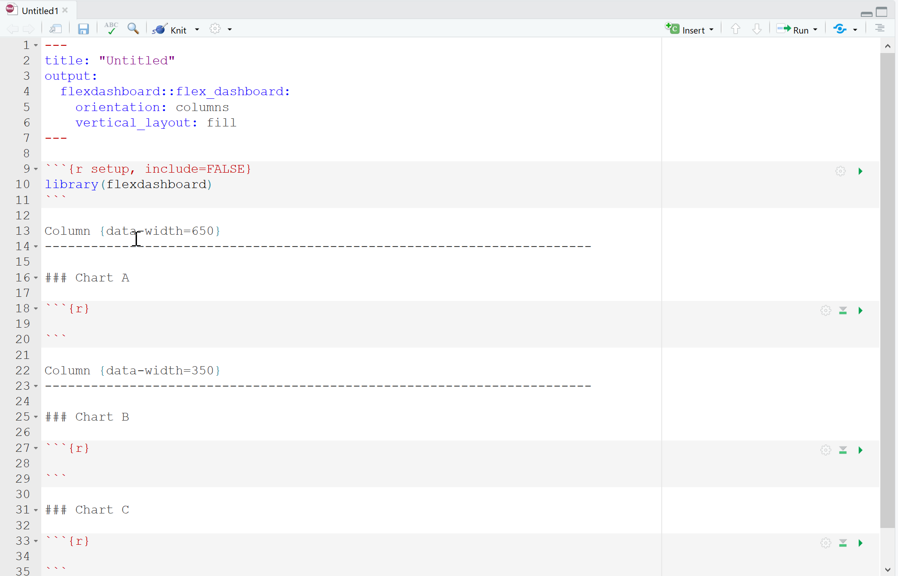
Flexdashboard
Can be deployed by either knitting to HTML or via ShinyApps.io
A really good example
https://walkerke.shinyapps.io/neighborhood_diversity/
Notes:
The flexdashboard layout system also adapts itself intelligently for display on mobile devices.
More information here: https://rmarkdown.rstudio.com/flexdashboard/using.html
The code: https://github.com/walkerke/neighborhood_diversity/blob/master/neighborhood_diversity_viridis.Rmd
A bunch more examples can be found here: https://rmarkdown.rstudio.com/flexdashboard/examples.html

Slide 26
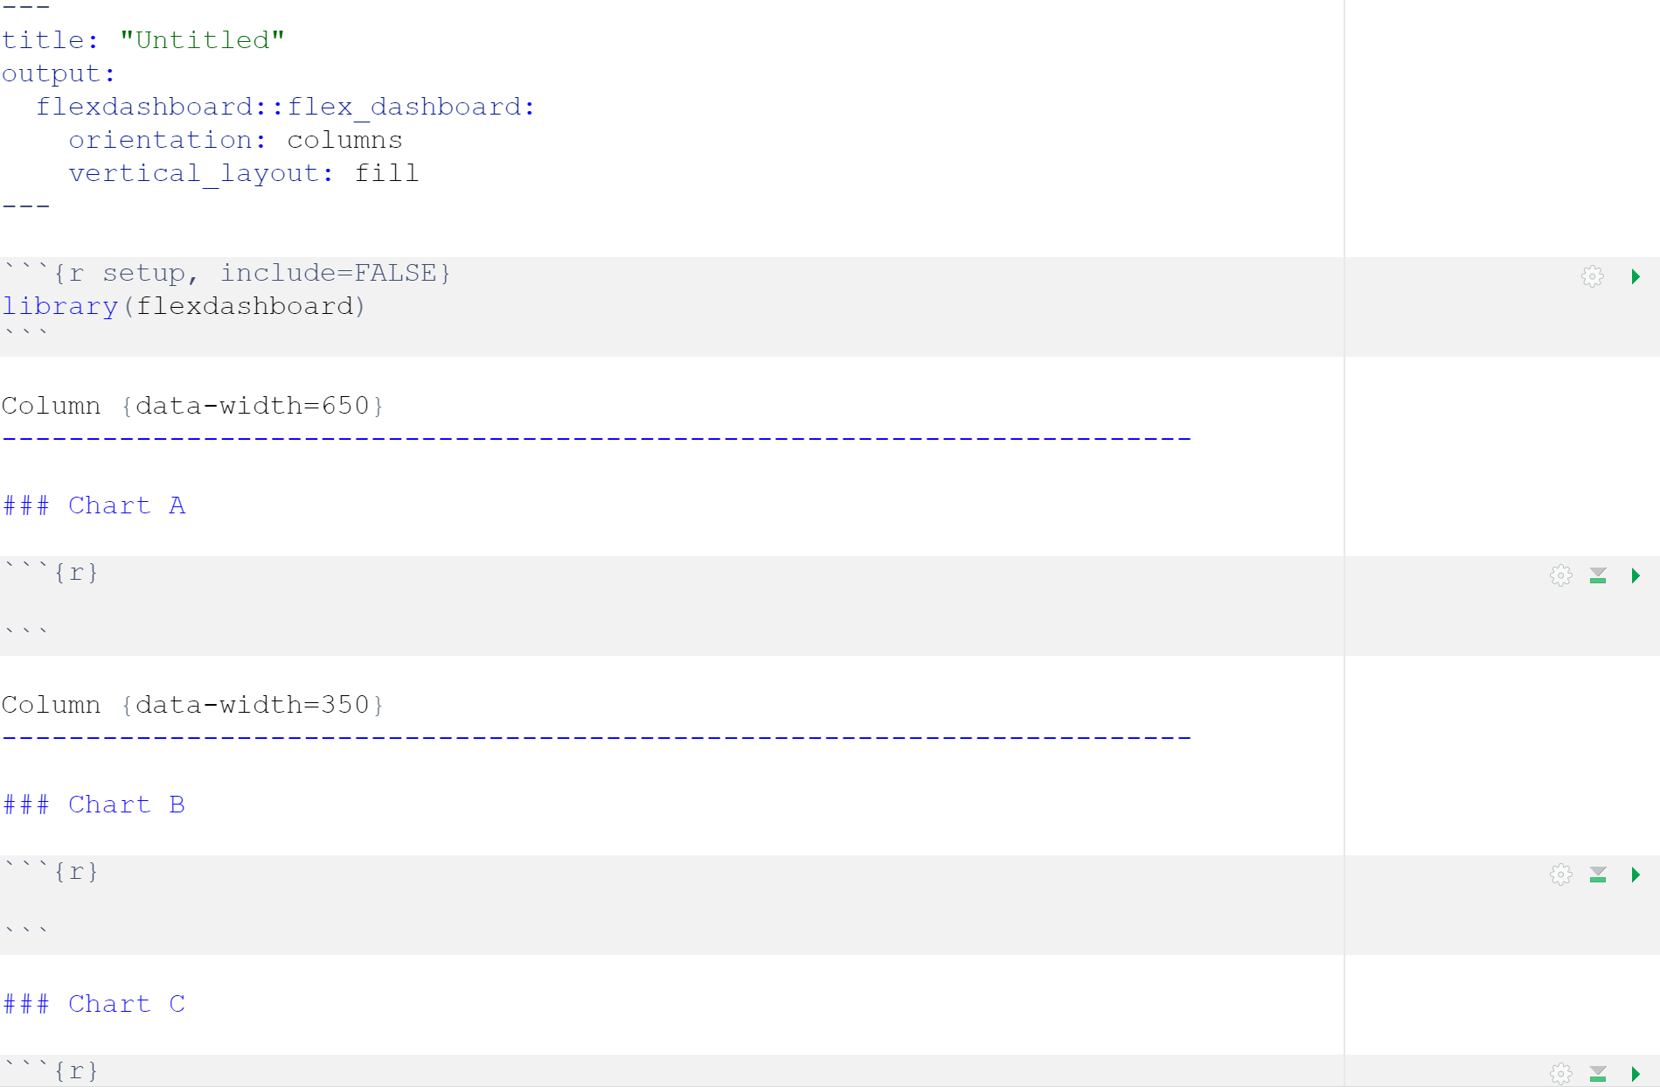

Flexdashboard - column layout

Slide 27
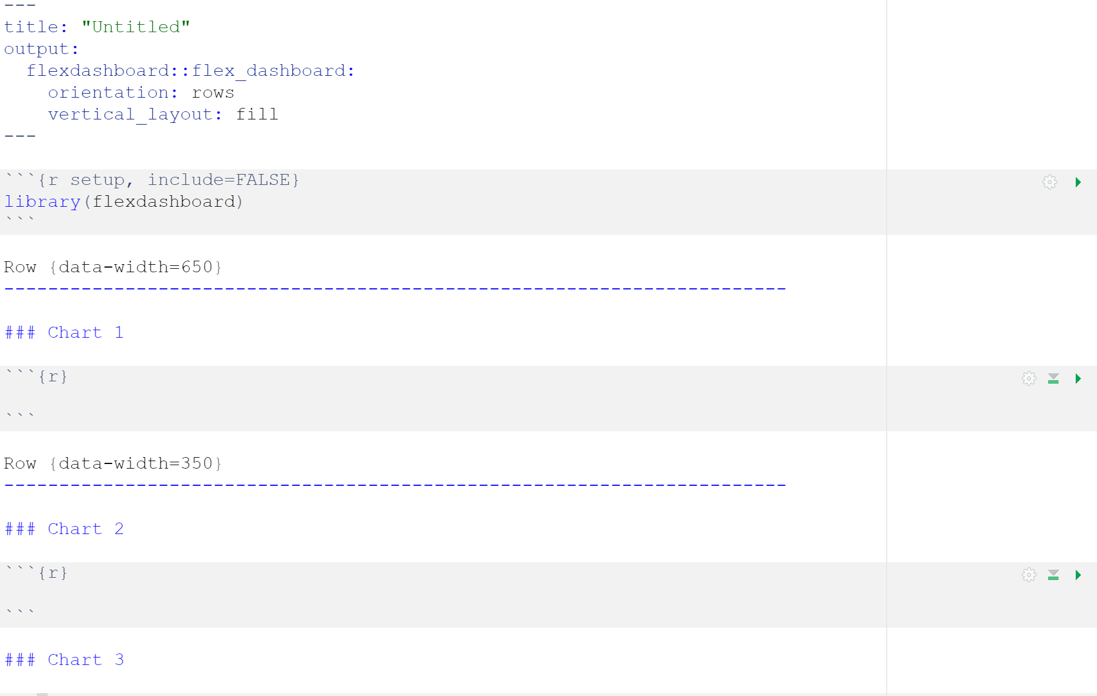

Flexdashboard - row layout

Slide 28
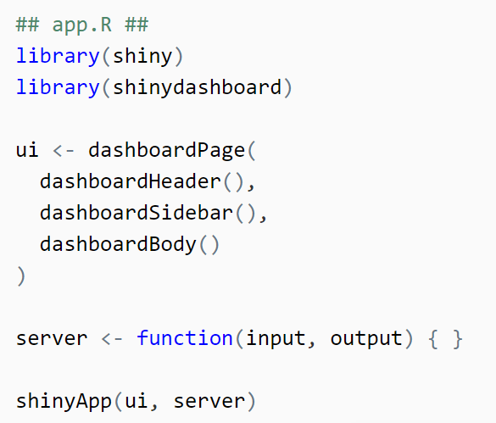
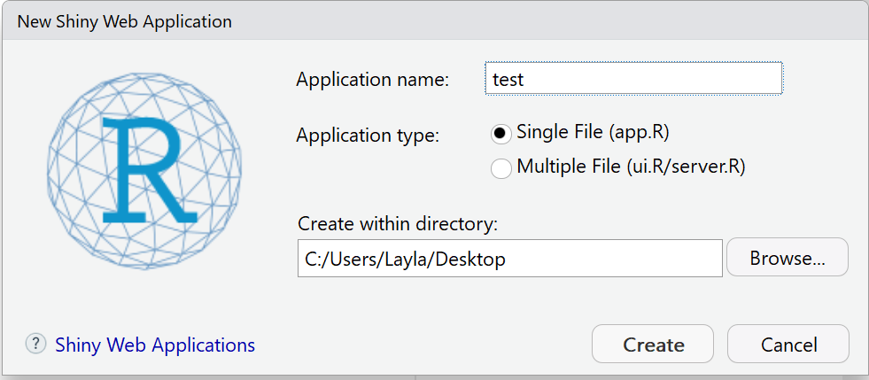
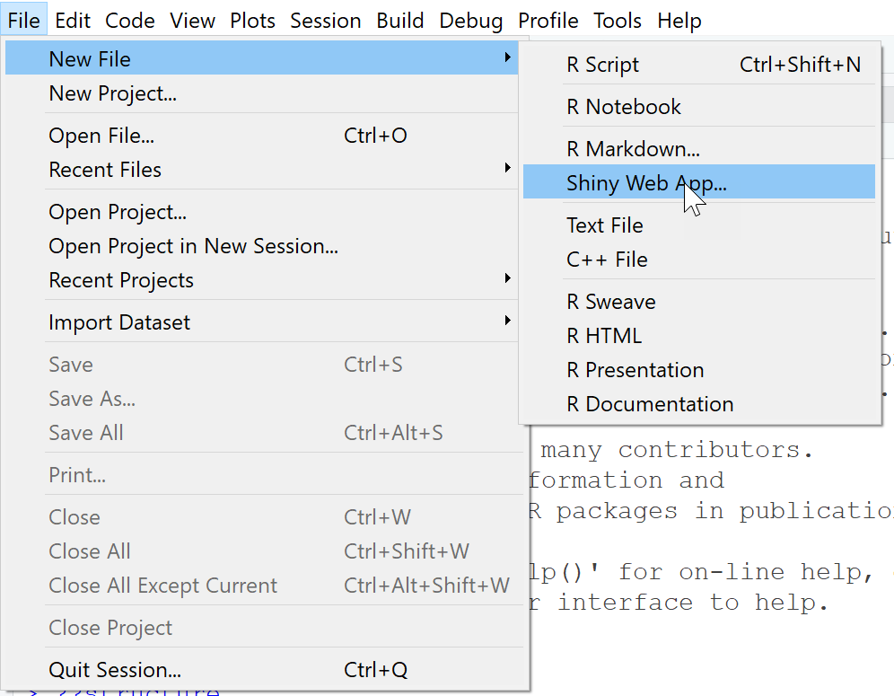
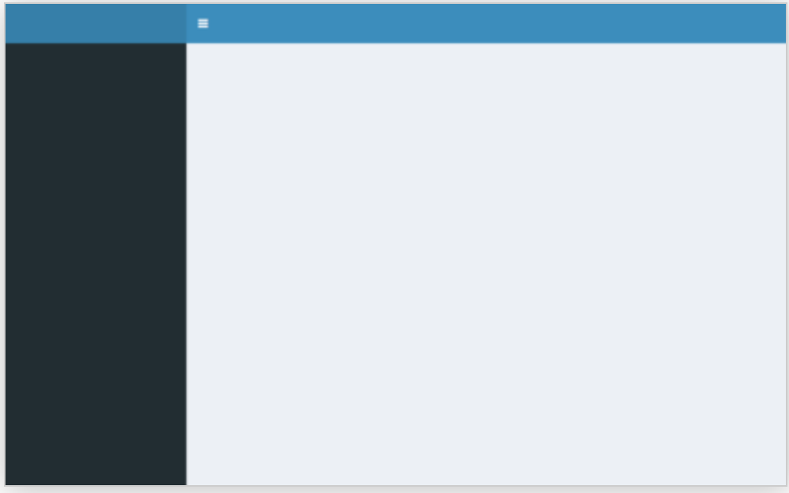
Shinydashboard
Body parts…
Notes:
Good guide: https://rstudio.github.io/shinydashboard/get_started.html

Slide 29
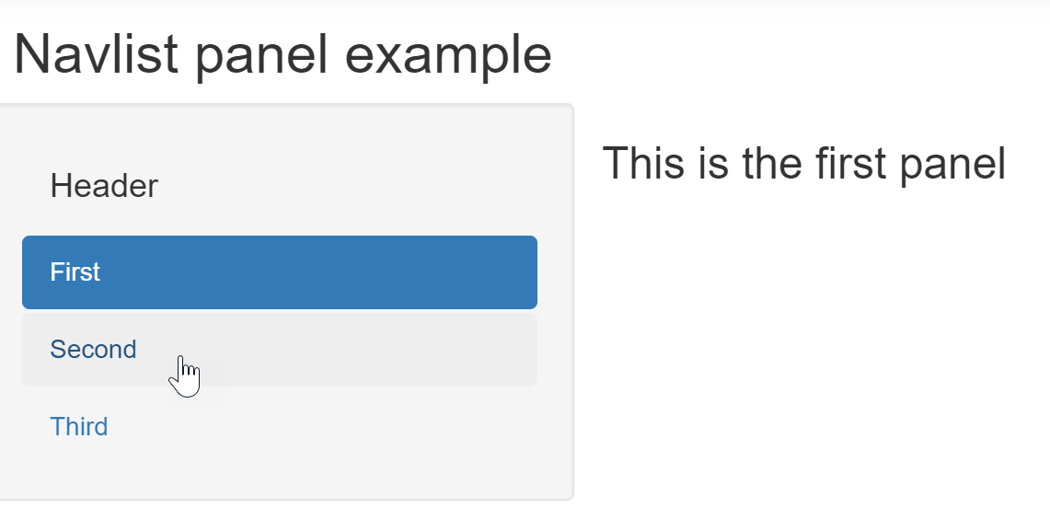
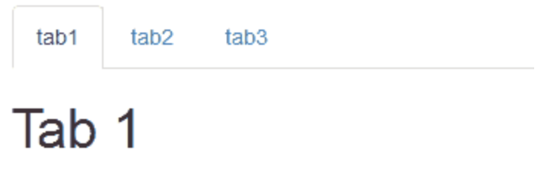
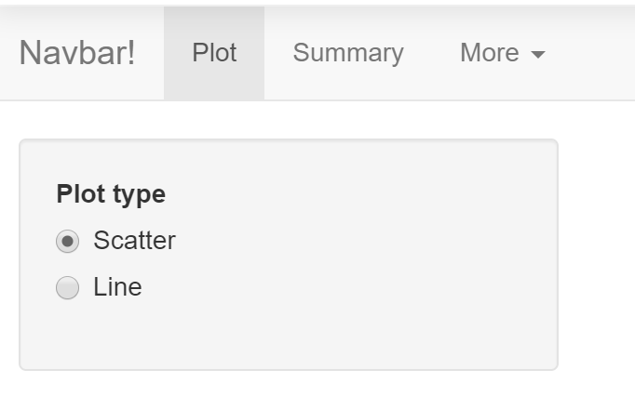
Tabs!
Types of tabs:
navlistPanel("Header",
tabPanel("First"),
tabPanel("Second"),
tabPanel("Third")
)
shinyDashboard's menu items are similar to this style
tabsetPanel(
tabPanel("tab1"),
tabPanel("tab2"),
tabPanel("tab3")
)
navbarPage(title = "Navbar!",
tabPanel("Plot"),
tabPanel("Summary"),
tabPanel("More")
)
Notes:
This link has a bunch of examples on how to use different features in shiny: https://shiny.rstudio.com/gallery/

Slide 30
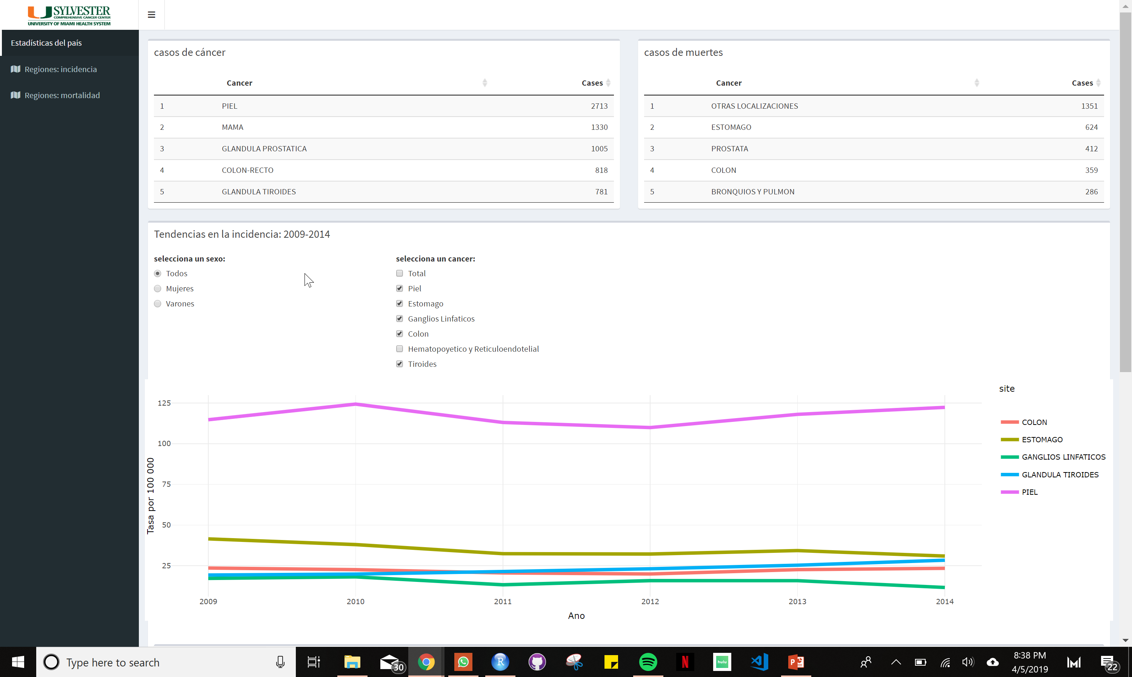
Just a little more complex - shinyCostaRica
Notes:
Go through code

Slide 31
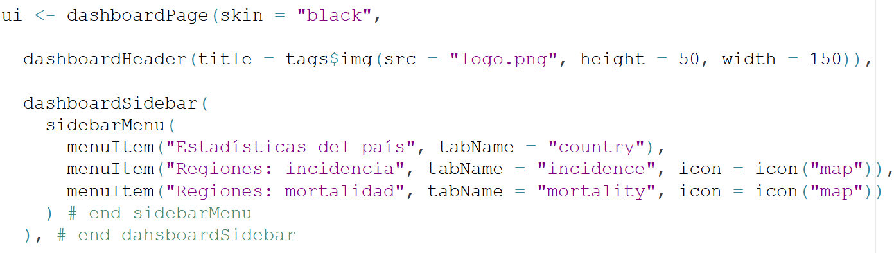
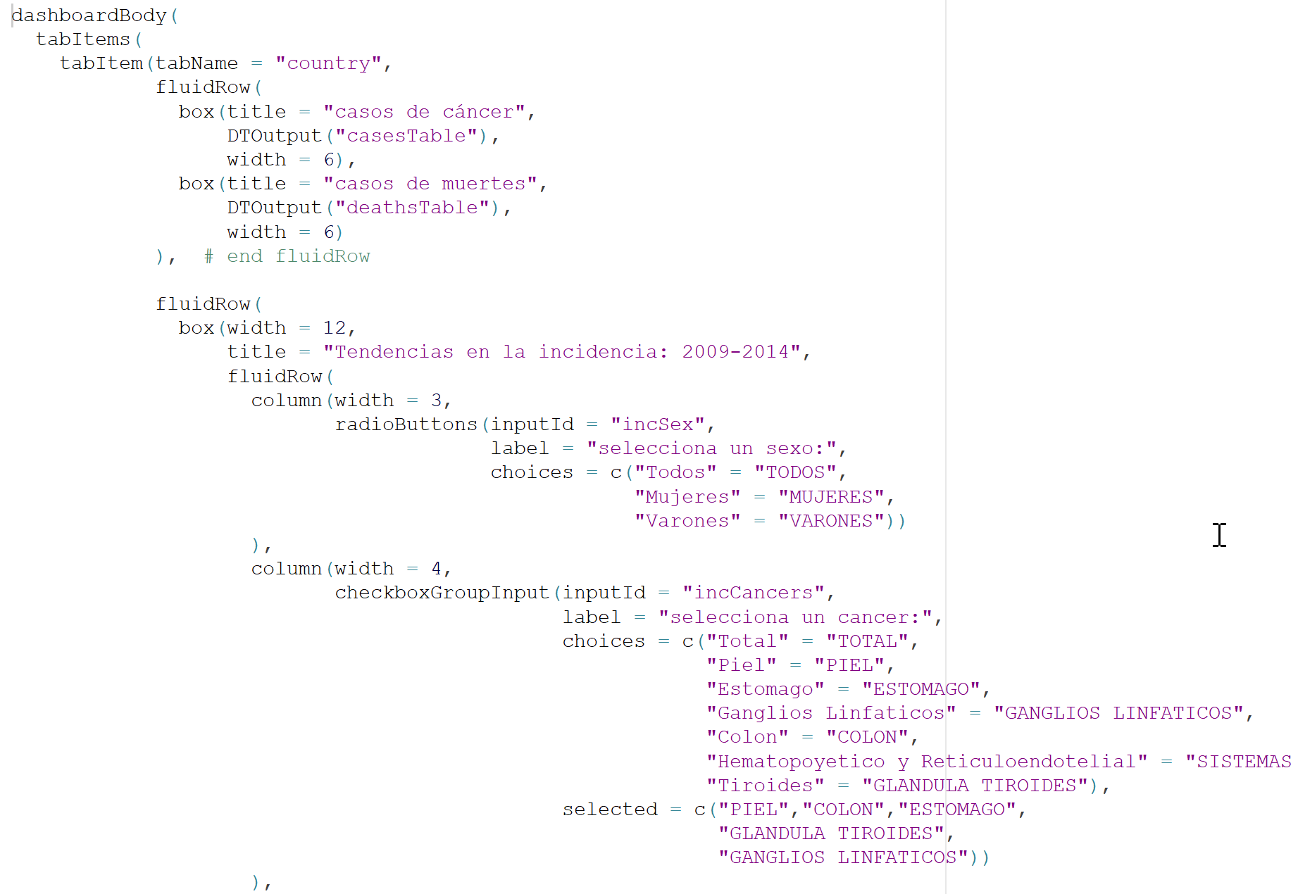
Body parts (ui)
Page
Header
Sidebar
Body
tabItems
tabItem

Slide 32
Body parts (ui)
This app uses a fluidRow() layout
Page divided into rows
Columns within rows
dashboardPage()
dashboardHeader()
tabItem()
dashboardSidebar()
tabItem()
dashboardBody()
fluidRow()
column()
column()
fluidRow()
column()
column()
12 px

Slide 33
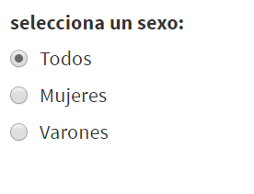
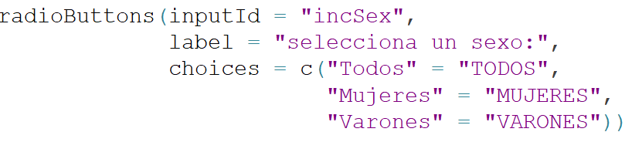
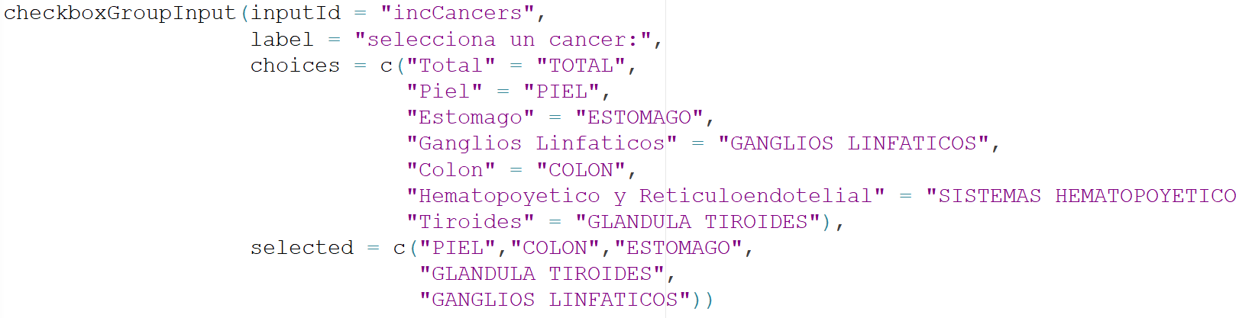
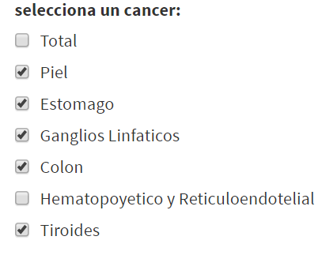
Inputs
radioButtons()
checkboxGroupInput()
Notes:
See cheat sheet for several more options!

Slide 34
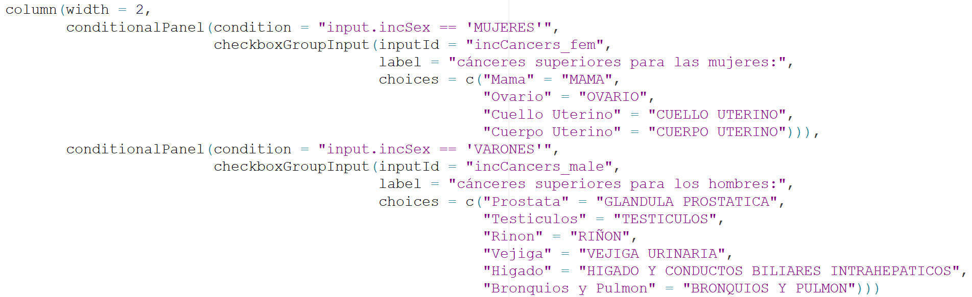
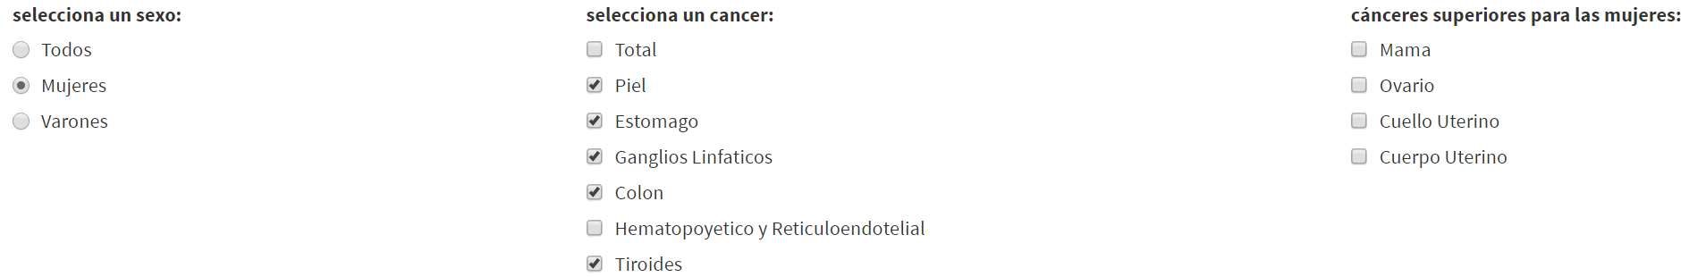
Conditions, Conditions
What’s that??
conditionalPanel() tells the ui to wait until a specific input item is selected (the condition) before displaying the input object (i.e. checkboxGroupInput() )
Display checkboxGroupIput “incCancers_fem”
Condition, “input.incSex == ’MUJERES’”, is met

Slide 35

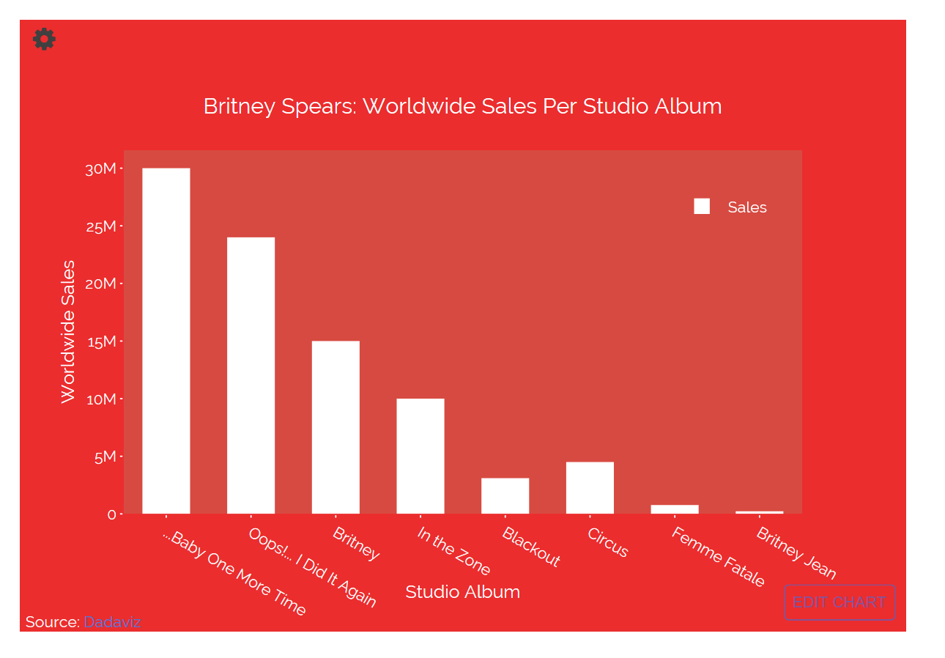
Plotly R
What is it?
A cool library that allows you to translate ggplot2 visualizations to interactive web-based versions or directly create a plotly within R
Simple example

Slide 36
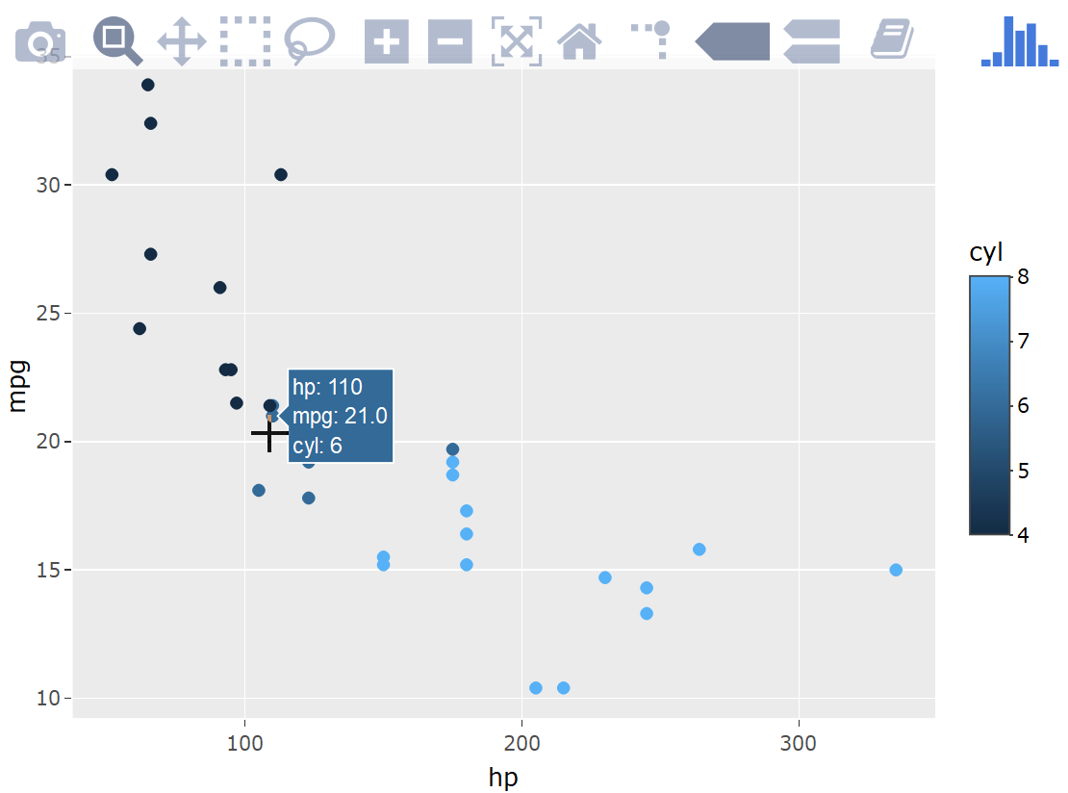
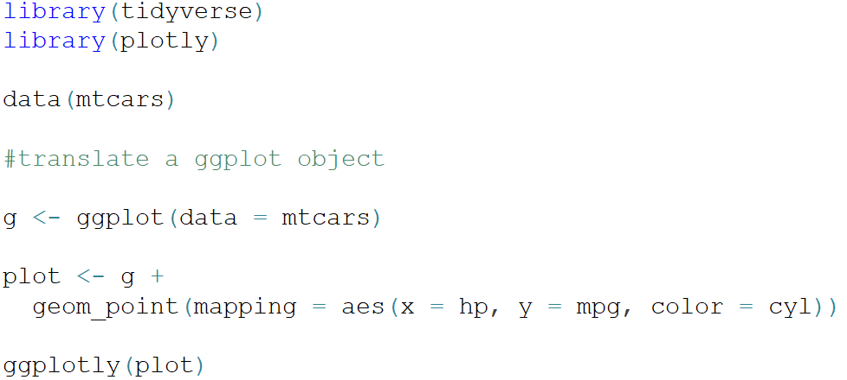
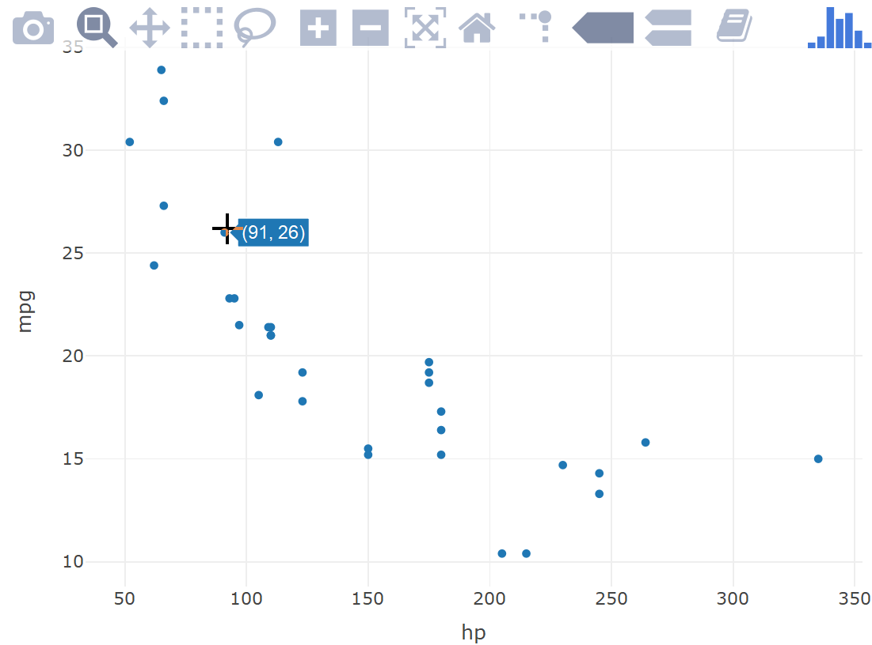
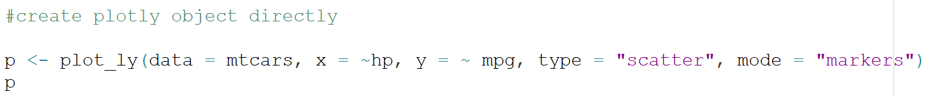
Plotly R (cont…)
Two options for creating a plotly:
Translating a ggplot object
Creating a plotly object directly
Notes:
Cheet sheet! https://images.plot.ly/plotly-documentation/images/r_cheat_sheet.pdf?_ga=2.256432459.1993740322.1554832057-1152457839.1554509979

Slide 37
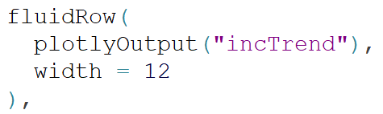
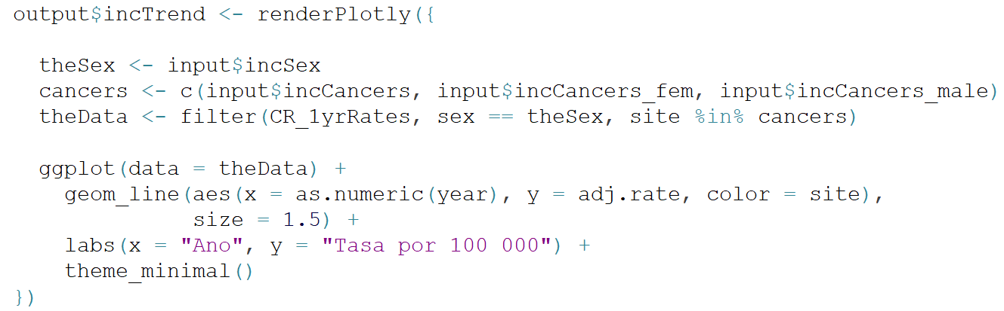
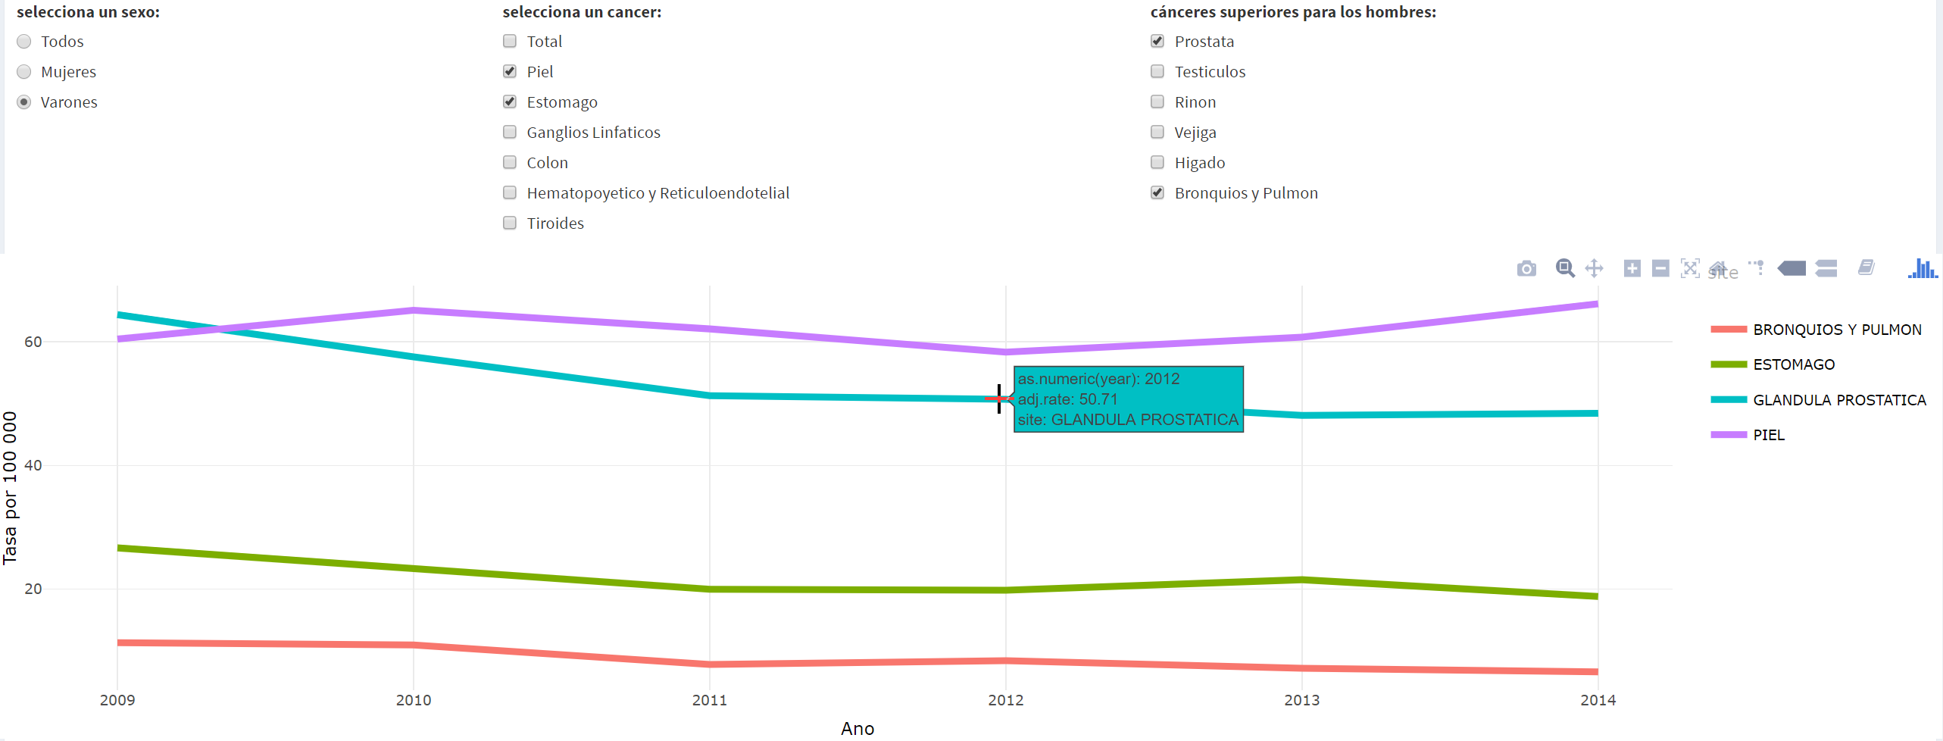
Plotly R (cont…)
ui
server

Slide 38

Exercise!
Plot mpg vs hp by number of cylinders using plotly
First add checkboxGroupInput for cylinder options
We will remove the option to group by transmission type
Then modify ggplot to be a plotly
Add to your baby app
myPlot <- renderPlotly({ stuff})
plotlyOutput("myPlot")

Slide 39

Mapping
What is leaflet?
JavaScript library used to build mapping applications for the web
Install.packages(“leaflet”)
Cheat sheet: https://ugoproto.github.io/ugo_r_doc/leaflet-cheat-sheet.pdf
Simple example :
Notes:
leaflet() creates the map widget
addTiles() adds the default OpenStreet map tiles
setView() sets the view to the provided coordinates with the provided zoom level, in this case NYC. (You can also create the map without the setView method.)

Slide 40


Let’s start with data
Types:
R dataframes
With latitudes and longitudes
i.e. fixed point data (location of hospitals)
Spatial
sp package
Converts R dataframes to spatial objects
spatialPolygonsDataFrame
spatialPoints
spatialLines
tigris package
Downloads Census TIGER/Line files and returns a spatialPolygonsDataFrame
Maps
maps package (limited)
map(database = “county”, region = “florida”)
Returns list of coordinates and names
Shapefiles downloaded independently from various opensource sources or created in Esri ArcGIS
rgdal package – read in shapefiles into R and convert to R objects
Notes:
Data sources:
Data.gov
http://hub.arcgis.com/pages/open-data

Slide 41

Leaflet Elements
Get spatial data- returns spatialPolygonsDataFrame
I want color. This could be a vector of colors or a function to get colors
Like in ggplot, create the leaflet object
addTiles() OR addProviderTiles()
Find a provider and add the tiles to the map
The fill color of the polygons
The outline color of the polygons
The opacity of the polygons
The stroke weight of the pixels
How much to simplify on each zoom level
The vector with data to fill the popup box
Since our spatial data is a dataframe of polygons – we add polygons to our map
Add a legend:
Color of the value box
Label of the value
Position of the legend on map
Title of the legend
Formatting of legend label
Notes:
addTiles() defaults to the OpenStreetMap tiles
You can add polygons (addPolygons() ) or fixed points (addMarkers() )
Smooth factor:
leaflet provider - http://leaflet-extras.github.io/leaflet-providers/preview/

Slide 42

Exercise
Let’s use the tigris and acs packages to map
tigris package downloads US Census TIGER/Line files for spatial analyses
Install.packages(“tigris”)
acs package uses the US Census API to pull data from the American Community Survey data
Get an api key: https://api.census.gov/data/key_signup.html (check email)
Install.packages(“acs”) > run library > api.install.key()
Let’s map the distribution of the
average number of cars across FL
counties
Install.packages("leaflet")

Slide 43


Exercise (cont…)
I've created the source code that makes the data for you!
makeVehicleSpatialData.r
Add the map to the ui and the server with leaflet
output$vehicleMap <- renderLeaflet({ stuff})
leafletOuput("vehicleMap")

Slide 44




A more complex example
Download shapefiles for CR
Read into R
3. Leaflet input object in the ui
4. Leaflet output object in the server

Slide 45

Product
https://labouz.shinyapps.io/costa-rica/

Slide 46

Let's put it all together!
Plop your babyApp code and Leaflet map into an app with two different tabs
Use app_complete.R
Tabs: Motor Trend, Mapping

Slide 47


Deployment
www.shinyapps.io
Register using GitHub account
Get token and secret
In R Studio → library(rsconnect)
Rmarkdown
Knitted as HTML

